Slide 1





Employee Attrition Prediction System
Predicting Employee Attrition Using Azure Data Science Tools
Blob Storage
Databricks
Delta Lake
MLflow
Azure ML
Git

Slide 2






Introduction
The Challenge
Employee attrition disrupts business operations
High recruitment and training costs
Loss of productivity and institutional knowledge Decreased team morale and cohesion
Unplanned Departures
Predictive Analytics
Retention Strategies
Business Impact
Project Goals
Predict attrition before it happens Enable data-driven retention strategies Build a scalable, reproducible solution Provide actionable insights for HR teams
150%
of annual salary
8-12
weeks to fill roles
Average cost and time impact of replacing employees

Slide 3








Project Objectives
Primary Goals
Ingest HR Data
Securely collect and store employee data from multiple sources
Transform Data
Clean, standardize, and prepare data for analytics
Model Attrition
Build machine learning models to predict employee departures
Deploy Solution
Deliver accessible predictions via API endpoints
Data Science Pipeline
Data | Data | Model | Model
Ingestion | Transformation | Building | Deployment
Key Metrics to Impact
Reduce Hiring Costs
by 25%
Success Criteria
85%+ prediction accuracy
Near real-time inference capability
Reproducible data pipeline
Seamless integration with HR systems
Improve Retention
by 15%
Boost Productivity
by 10%
Enhance Satisfaction
by 20%

Slide 4
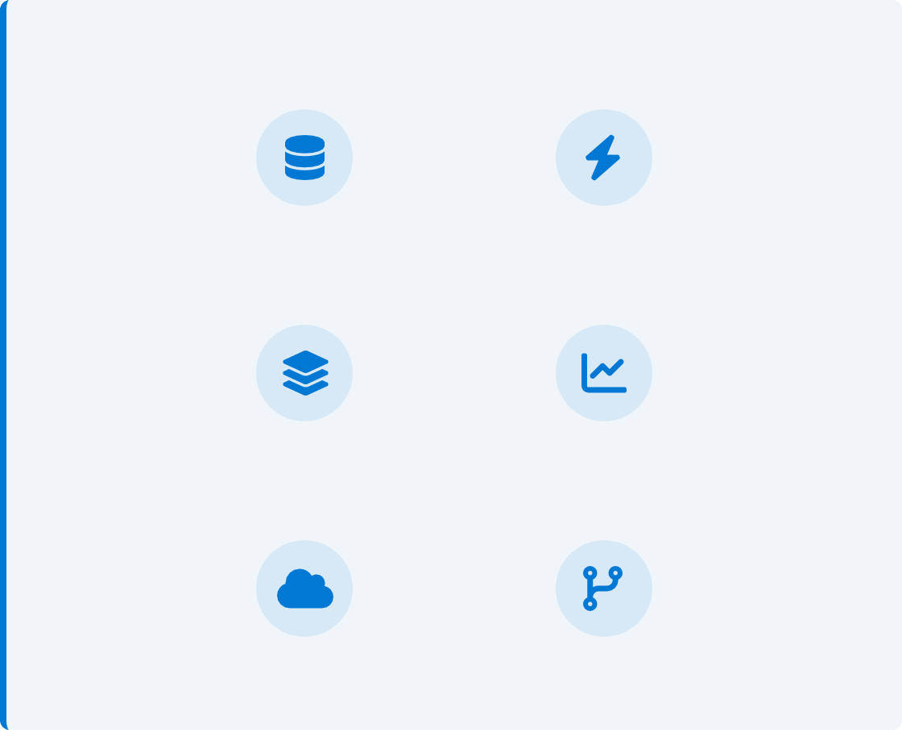






Tech Stack
Data Storage & Processing
Azure Blob Storage
Secure, scalable object storage for unstructured data including HR datasets and raw files
Azure Databricks
Collaborative analytics service for large-scale data processing and model training
Delta Lake
Reliable data lake format with ACID transactions, schema enforcement, and time travel capabilities
Technology Integration
Azure Blob Storage
Azure Databricks
Delta Lake
MLflow
Model Training & Deployment
MLflow
Open-source platform for managing the ML lifecycle, including experiment tracking and model registry
Azure Machine Learning
Enterprise-grade service for the end-to-end ML lifecycle and secure model deployment
Git
Version control system for collaborative notebook development and code
management
Azure ML
Git
Key Benefits
Enterprise-grade Security
High Performance
Scalability
Reproducibility
Seamless Integration

Slide 5





Solution Architecture
Our end-to-end architecture enables seamless data flow from ingestion to prediction, with version control and reproducibility built in at every stage.
Azure Blob Storage
Raw HR Data Storage
Git
Notebook Version
Control
HR CSV Files
Azure Databricks
Data Engineering & Analytics Platform
Bronze Layer
Raw data ingestion Schema enforcement Blob Storage mounting
Silver Layer
Gold Layer
Feature engineering Model-ready datasets Business aggregations
Data cleaning Type casting
Initial transformations
MLflow
Experiment Tracking & Model Registry
XGBoost model training Hyperparameter tuning Experiment logging
Azure Machine Learning
Model Deployment & Serving
Model registration REST API endpoints Real-time inference

Slide 6






Data Ingestion
Azure Blob Storage Integration
Securely mount Blob Storage to Databricks Authentication via Azure Key Vault secrets Role-based access control for data governance Persistent mount point for continuous access
Azure Blob Storage
Azure Databricks
Mounting Storage Example
dbutils.fs.mount(
source = "wasbs://hr-data@storageacct.blob.core.windows.net", mount_point = "/mnt/hr-data",
extra_configs = {
"fs.azure.account.key.storageacct.blob.core.windows.net": dbutils.secrets.get("key-vault-secrets", "storage-account-key")
}
CSV Data Reading
Read HR datasets with schema inference Automatic handling of historical data files Optimized Spark CSV reader configuration
Initial data loaded to Bronze layer for processing
)
Reading CSV Files
df = spark.read \
.option("header", "true") \
.option("inferSchema", "true") \
.csv("/mnt/hr-data/employee_data.csv")
# Write to Bronze layer df.write.format("delta") \
.mode("overwrite") \
.save("/mnt/delta/bronze/employee_data")

Slide 7












ETL Process
Data Transformation Layers
Our ETL pipeline follows the medallion architecture pattern to progressively transform raw data into business-ready insights:
Data Transformation Flow
Bronze Layer (Raw)
Ingest raw data from CSV files in Blob Storage Preserve original schema and content
Maintain historical record of source data
Add metadata: ingestion timestamp, source
Bronze Layer
Raw, unprocessed data
Data validation
conversion
Silver Layer
Remove duplicates
Type
Silver Layer (Cleaned)
Data cleansing and validation
Filter irrelevant or duplicate records
Type casting and schema enforcement Standardize formats and values
Cleaned, validated data
Aggregate metrics
Gold Layer
Feature engineering
Analytics-ready data
Gold Layer (Analytics-Ready)
Aggregated and enriched datasets Pre-calculated metrics and KPIs Feature-engineered attributes Optimized for ML model consumption
Delta Lake Advantages
Time Travel Schema Evolution
ACID Transactions
Data Lineage

Slide 8







Model Training
XGBoost Implementation
Gradient boosted decision trees for classification High performance with tabular data Hyperparameter tuning using grid search Feature importance analysis
Class imbalance handling with scale_pos_weight
Gold Layer Dataset
XGBoost Model
Attrition Predictions
MLflow Experiment Tracking
Experiment: Attrition_Prediction_XGBoost Run #452
Parameters:
max_depth: 5
MLflow Tracking
Experiment version history & comparison Automatic logging of metrics & parameters Model artifact storage & retrieval
Pipeline tracking for reproducibility
learning_rate: 0.1
n_estimators: 200
subsample: 0.8
Metrics:
Accuracy: 0.87
Precision: 0.67
Model Saved
AUC: 0.80
Recall: 0.49
Source: train_model.py
Duration: 124s

Slide 9
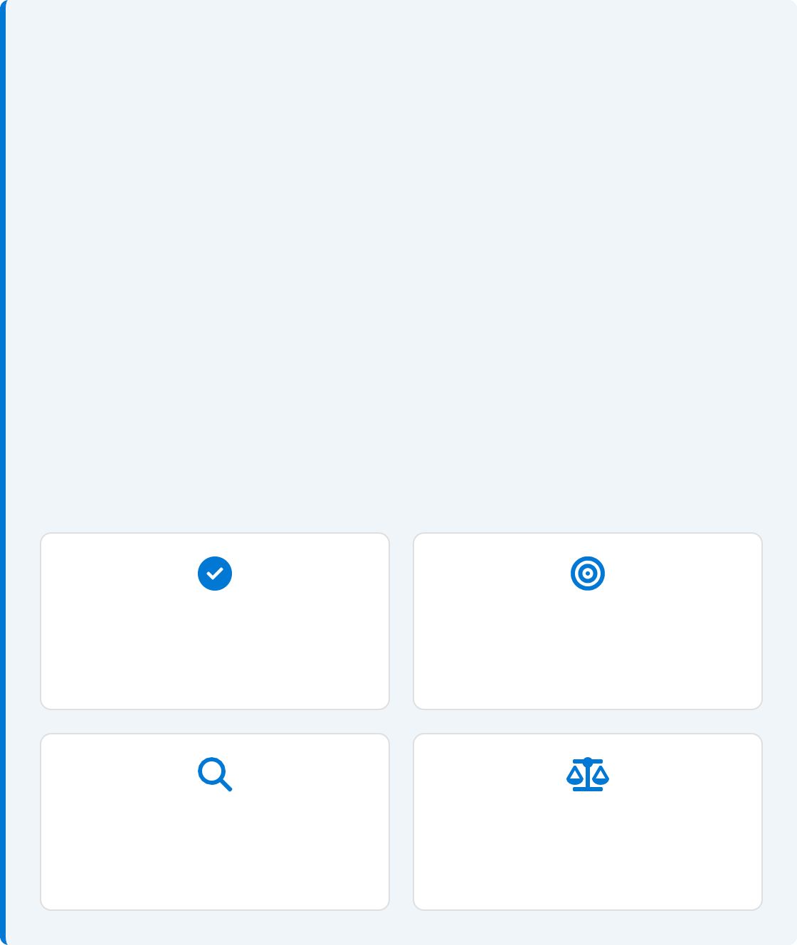
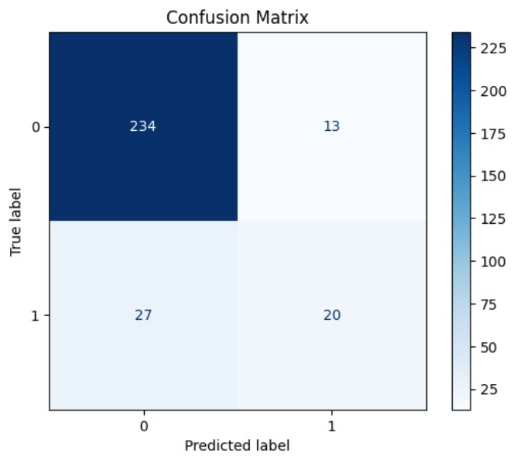

Model Evaluation
Confusion Matrix
Visualization of prediction results showing:
ROC Curve
Receiver Operating Characteristic curve showing model performance across different thresholds:
AUC
Score
0.80
Key Insight: Model performs exceptionally well at distinguishing between employees likely to stay versus those at risk of leaving
Accuracy
86.4%
Precision
66.7%
Recall
43.2%
F1 Score
50.9%

Slide 10
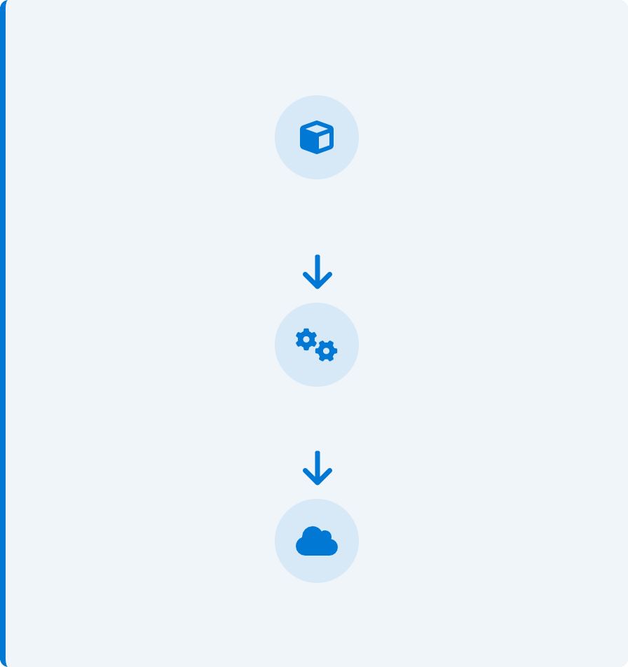


Model Deployment
Azure ML Deployment
Register trained model in Azure ML Model Registry Package model and dependencies in container Deploy as managed endpoint with autoscaling Secure with Azure AD authentication
Deployment Flow
Trained Model (MLflow)
REST API Features
Low-latency real-time predictions JSON request/response format Load balancing for high throughput Performance monitoring & logging
Azure ML Model Registry
Deployed REST API Endpoint

Slide 11
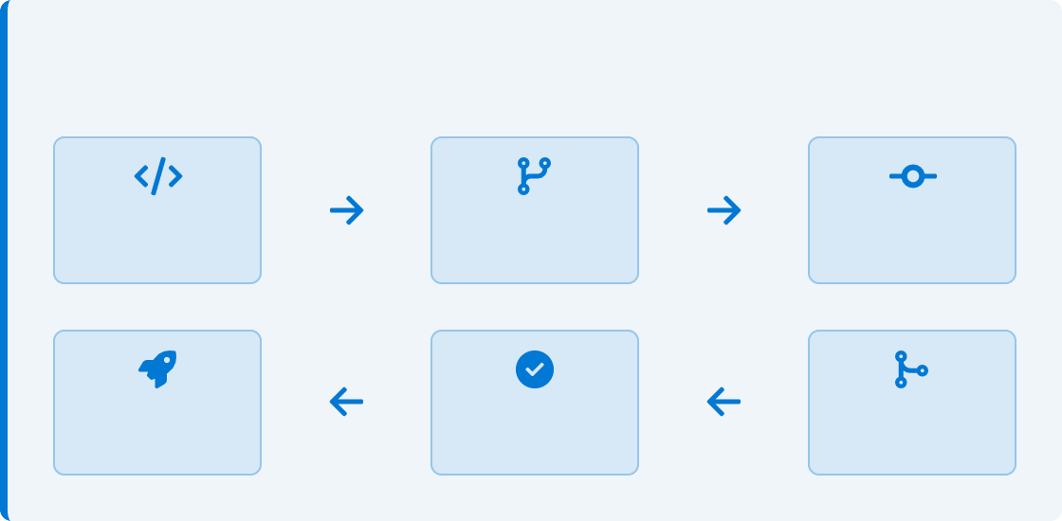
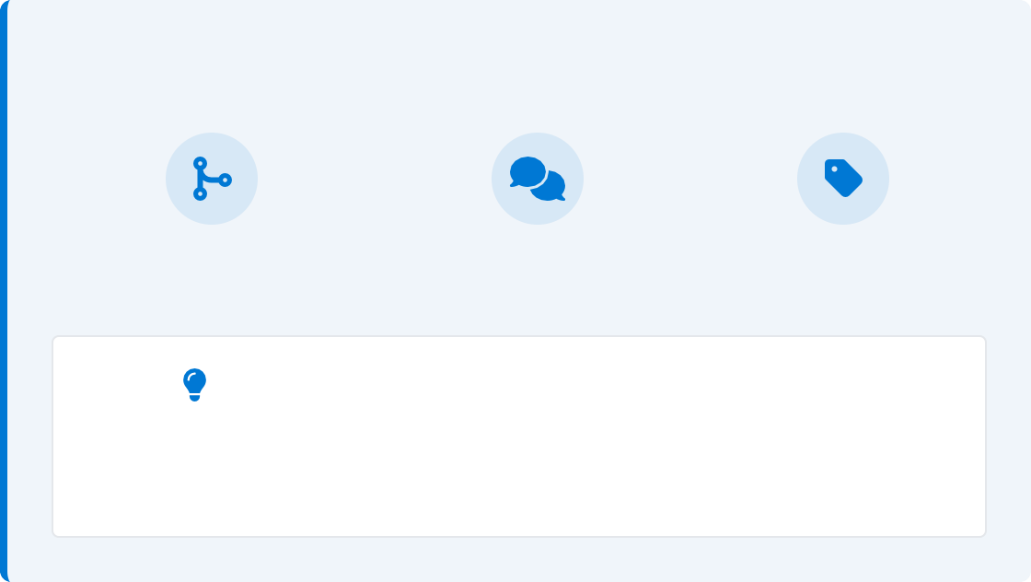


Git Integration
Version Control Workflow
Track changes to all Databricks notebooks Branch notebooks for experimental features Maintain complete history of code changes Roll back to previous versions if needed
Git Workflow
Development
Branch
Commit
Deploy
Approve
Merge
Benefits
Enhanced team collaboration Easier debugging and issue tracking
Reproducible data science experiments Code review and quality assurance Project progress tracking
Collaboration Features
Pull Requests
Code Reviews
Versioning
Git enables multiple data scientists to work simultaneously on the same project without conflicts,
maintaining code quality and project history.

Slide 12






Conclusion
Project Outcomes
End-to-end attrition prediction system using Azure's
scalable ecosystem
Reliable data pipeline with Bronze-Silver-Gold architecture High-accuracy machine learning model with XGBoost
Production-ready REST API for real-time predictions Version-controlled, reproducible solution with Git
Future Scope
New Features
Incorporate employee sentiment analysis and external market data
Continuous Training
Implement automated model retraining pipelines
KPI Integration
Connect model predictions with business performance metrics
Business Impact
Reduced recruitment and training costs Improved talent retention strategies Data-driven HR decision making
Enhanced employee satisfaction and engagement
Ready for the Future
This solution provides a foundation for advanced HR analytics and strategic workforce planning

